Slide 1

TEXT ENCRYPTION USING VARIOUS ALGORTHIMS
S SIVA KARTHIK REDDY-2010030329
E.R SUMANTH -2010030051
K.SNEHITH-2010030341

Slide 2

ABSTRACT
This presentation contains the details of the project ‘text encryption using various algorithms’.
Text-encryption is a process in which the message send by the sender is encrypted so that only receiver can understand the message.
Encryption converts data into scrambled text. The unreadable text can only be decoded with a secret key.
The decoded text can be read by the receiver which maintains the security

Slide 3
INTRODUCTION
Cryptography is a science of secret writing. It is the art of protecting the information by transforming it into an unreadable format in which a message can be concealed from reader and only the intended recipient will be able to convert it into original text. Its main goal is to keep the data secure from unauthorized access. Data can be read and understood without any special measures is called plaintext. The method of disguising plaintext in such a way as to hide its substances is called encryption. Encrypting plaintext results in unreadable gibberish called ciphertext.

Slide 4
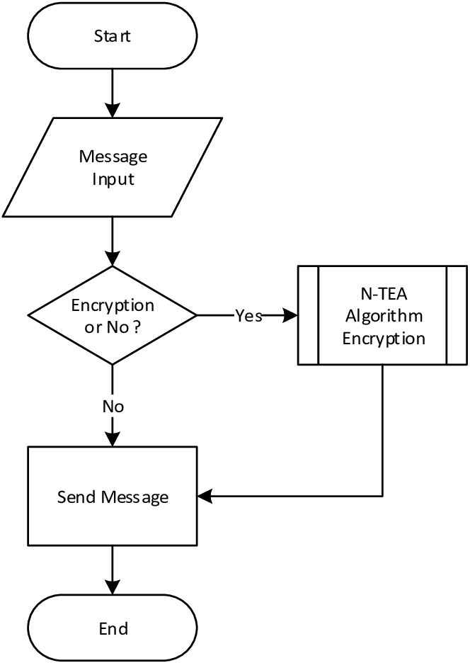
Flowchart

Slide 5
METHODOLOGY
1.ADVANCED ENCRYPTION STANDARD(AES):
AES is a symmetric cryptographic algorithm published by NIST.
The algorithm was proposed by Rijndelal.
AES is replacement of DES.
AES works on block cypher technique, size of plain text and cipher text must be same.
Input key is also required by the algorithm, same size of plain text.
Unlike any algorithm AES consist of different cipher key length(128,192,256,1024).

Slide 6
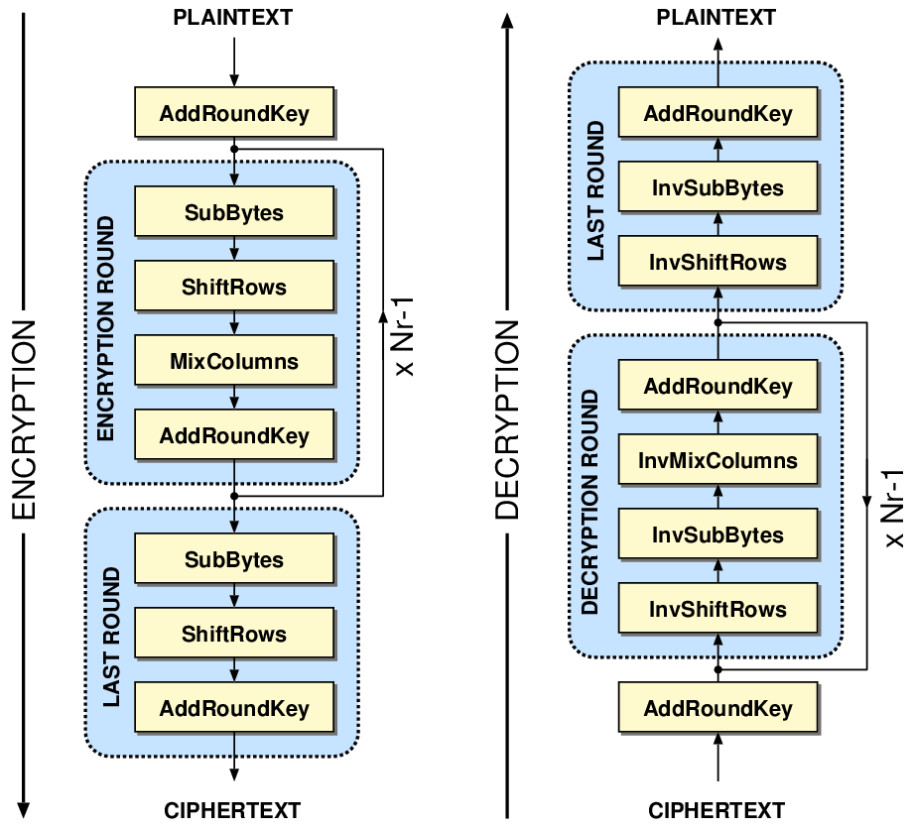
IMPLEMENTATION

Slide 7

The algorithm in AES each round has 4 steps:
Sub Bytes
Shift Rows
Mix Columns
Add round key

Slide 8
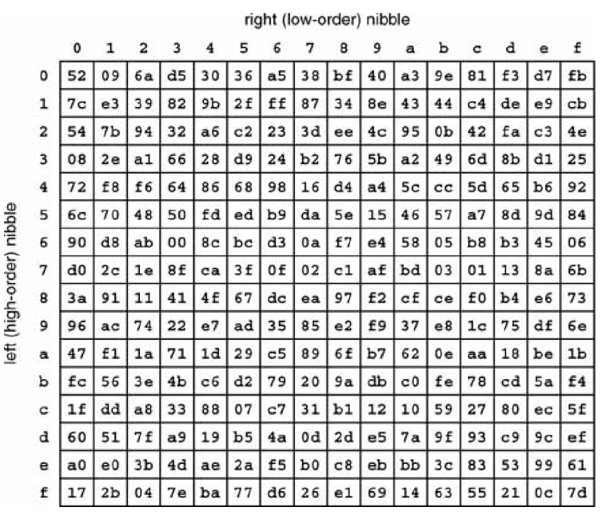
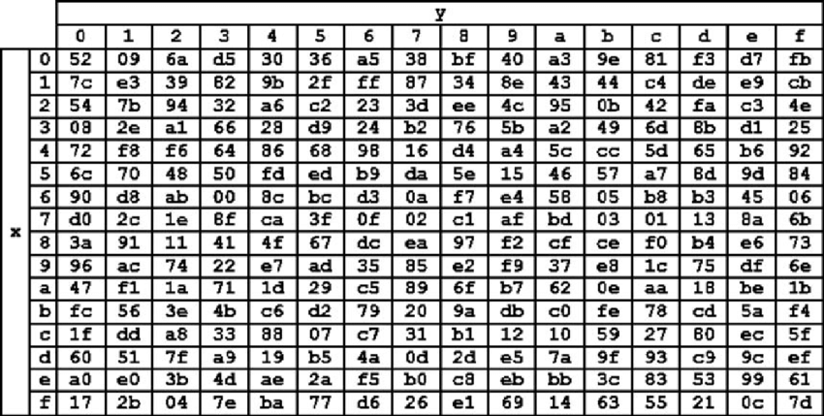
1.SUB BYTES
S-box
Inversed S-box

Slide 9
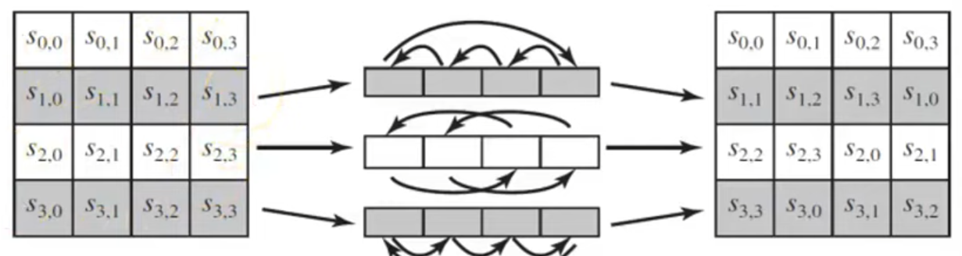
2.Shift Rows

Slide 10
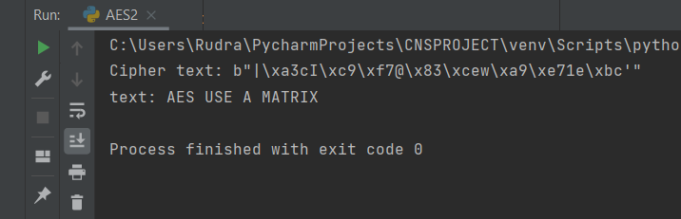
OUTPUT FOR AES

Slide 11
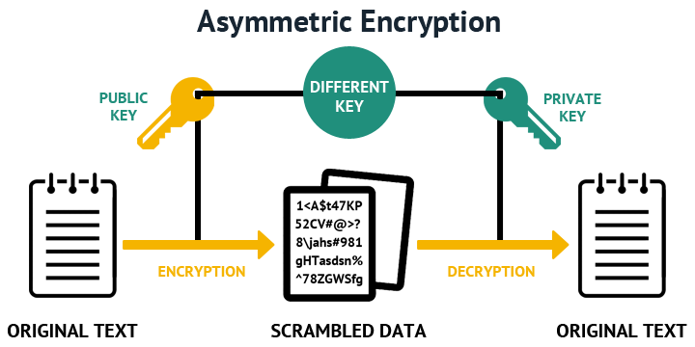
How does Asymmetric Encryption work?
Asymmetric Encryption robustly addresses these challenges with a pair of keys: a public key and a private key. While the data is encrypted at the sender’s end using the receiver’s public key and the data exchanged is decrypted by the receiver using his private key.

Slide 12
2.RIVEST-SHAMIR-ADLEMAN(RSA):
RSA is a public key cryptosystem that is widely used for secured data transmission.
RSA was designed by Ron Rivest, Adi Shamir, Leonard Adleman.
RSA is a factorizing technique.
The security of RSA relies on practically difficulty of factoring the product of two large prime numbers

Slide 13
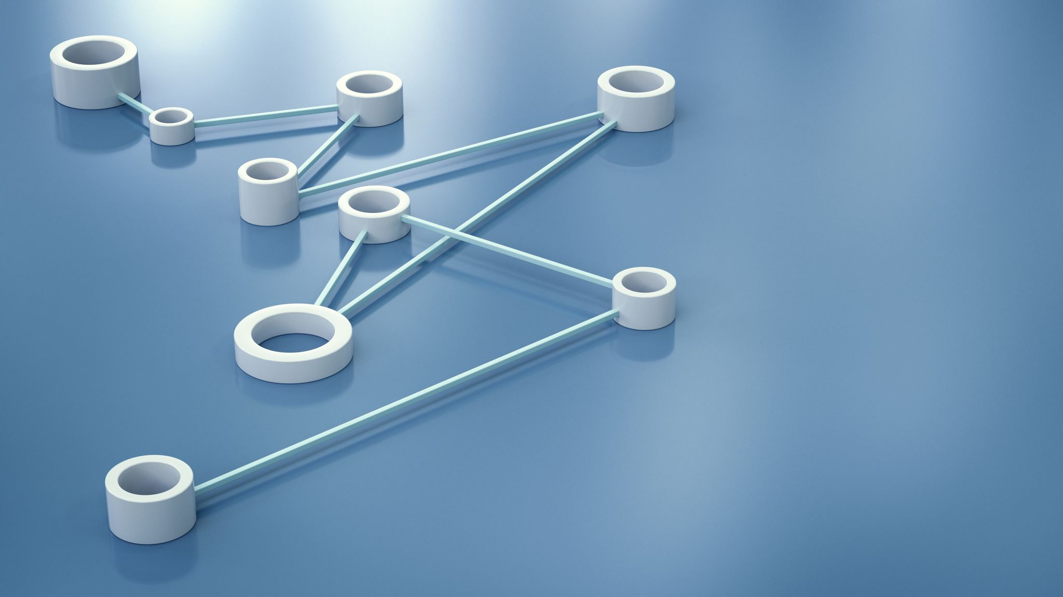
IMPLEMENTATION
There are 4 steps involved in algorithm for RSA:
Key generation
Key distribution
Encryption
Decryption

Slide 14
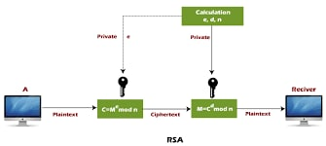
RSA IN NUTSHELL

Slide 15
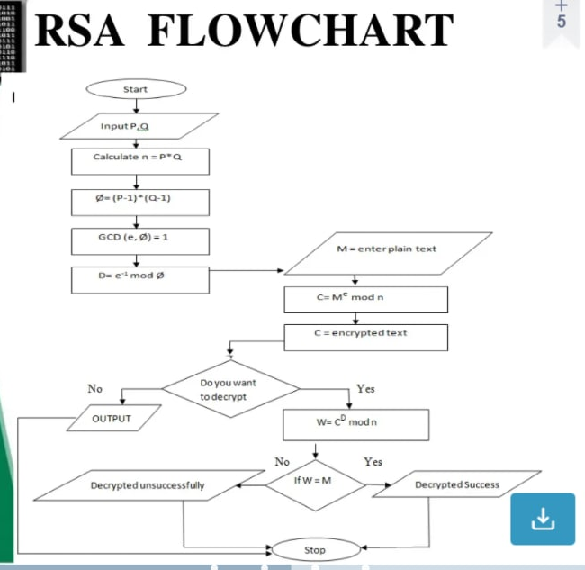
FLOW CHART

Slide 16
1.Key Generation
Take two distinct random prime numbers.
Compute their product and name it as ‘n’.
Compute the L.C.M of the predecessors of the two prime numbers and let it be λ(n).
Chose another random number whose range lies in between 1, λ(n).
Let d be d ≡ e⁻¹ (mod λ(n)).

Slide 17
2.Key Distribution
Suppose that Bob wants to send information to Alice. If they decide to use RSA, Bob must know Alice's public key to encrypt the message, and Alice must use her private key to decrypt the message. To enable Bob to send his encrypted messages, Alice transmits her public key (n, e) to Bob via a reliable, but not necessarily secret, route. Alice's private key (d) is never distributed.

Slide 18
Encryption
After Bob obtains Alice's public key, he can send a message M to Alice. To do it, he first turns M (strictly speaking, the un-padded plaintext) into an integer m (strictly speaking, the padded plaintext), such that 0 ≤ m < n by using an agreed-upon reversible protocol known as a padding scheming. He then computes the ciphertext c, using Alice's public key e, corresponding to
C=m^e (mod n).

Slide 19
Decryption
Alice can recover m from c by using her private key exponent d by computing
C^d=(m^e)^d

Slide 20
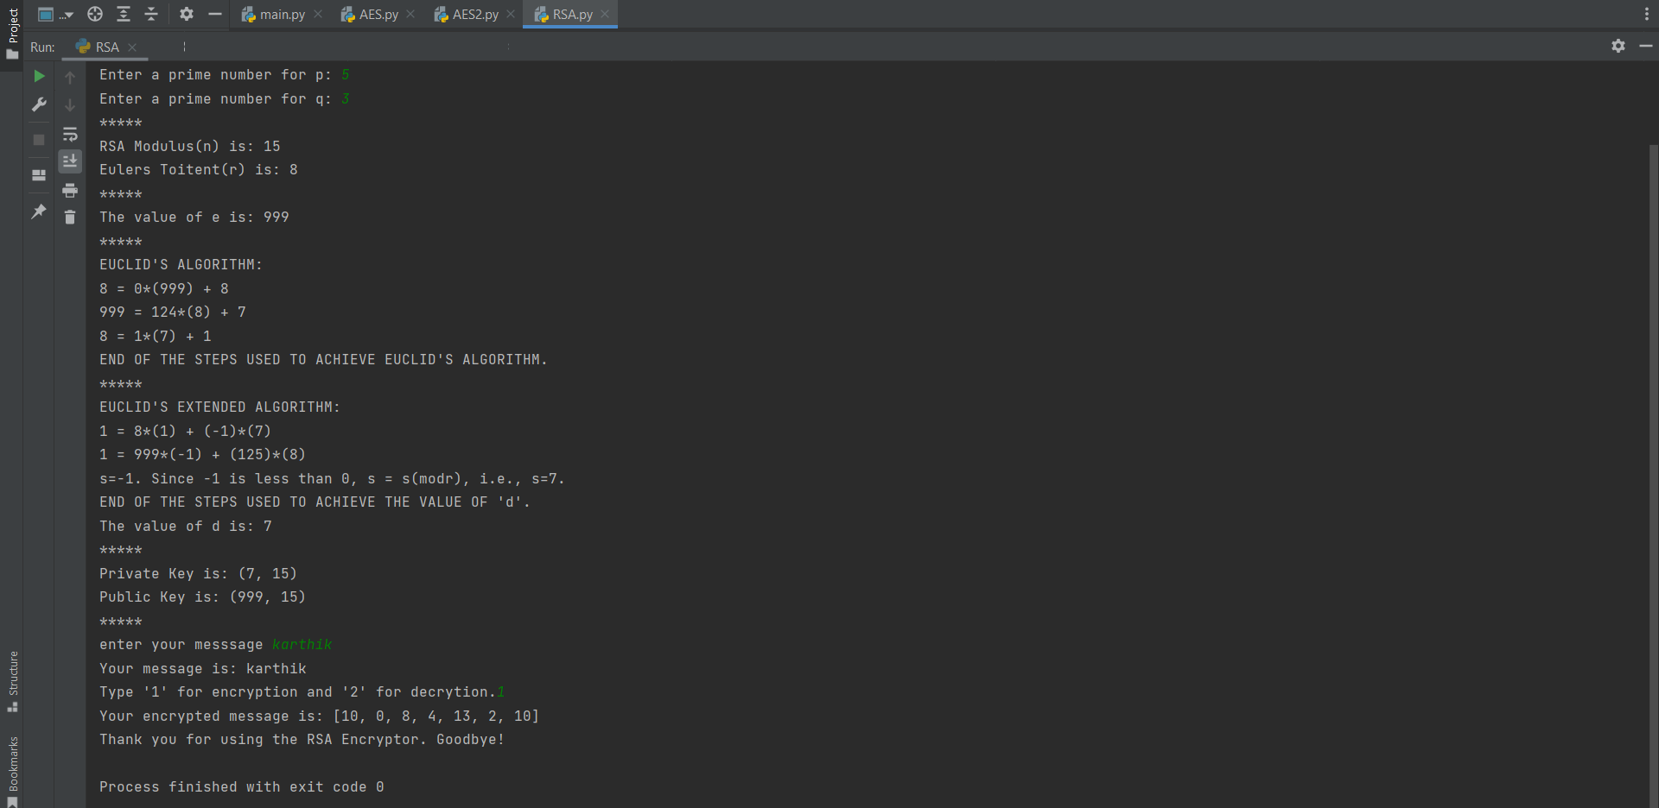
Output

Slide 21

THANK YOU

